Slide 1
Statistical evaluation of AI
24th of January 2020
Lukas Leindals, Peter Grønning and Rasmus Bryld
24. Jan. 2020
DTU Compute

Slide 2
Project 1
Project 1
Human arm trajectories in obstacle avoidance
24. Jan. 2020
DTU Compute

Slide 3
Introduction
Data and experiment
Predicting the participant in experiment 5
Does the experiment matter?
24. Jan. 2020
DTU Compute

Slide 4
Method - models
KNN and MLR
Low complexity
Evaluation
Leave-One-Out Cross validation
Accuracy with Jeffrey CI’s
Comparison
McNemar
24. Jan. 2020
DTU Compute

Slide 5
Method - One-Way ANOVA
Compress each curve to a single value
Max - Min
3 one-way ANOVAs, one for each axis
P-values must be adjusted
Bonferroni and Benjamini-Hochberg
24. Jan. 2020
DTU Compute

Slide 6
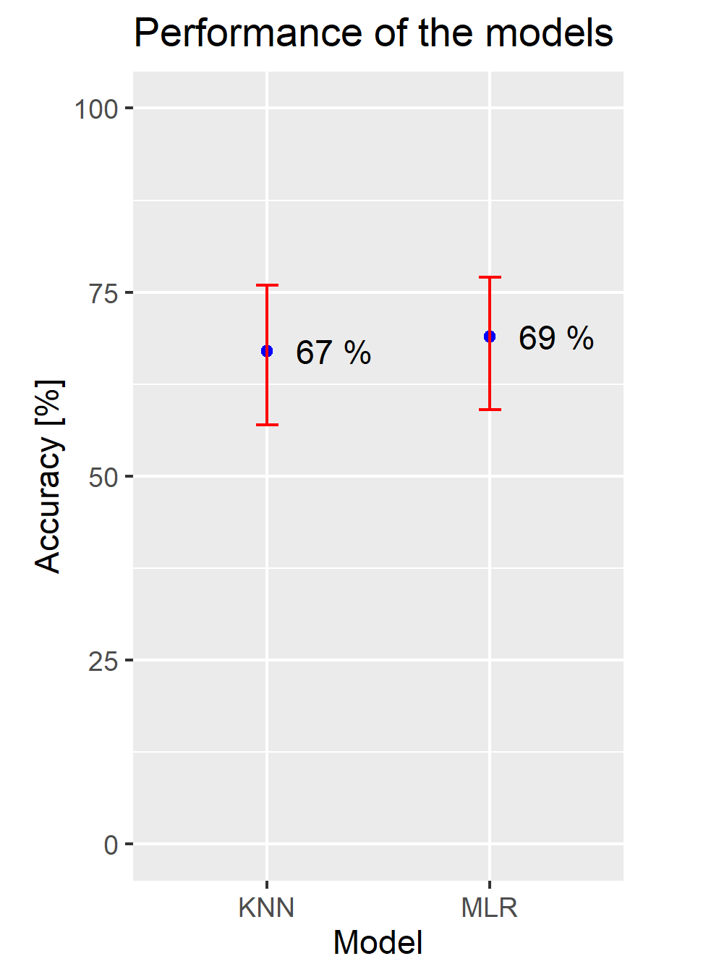
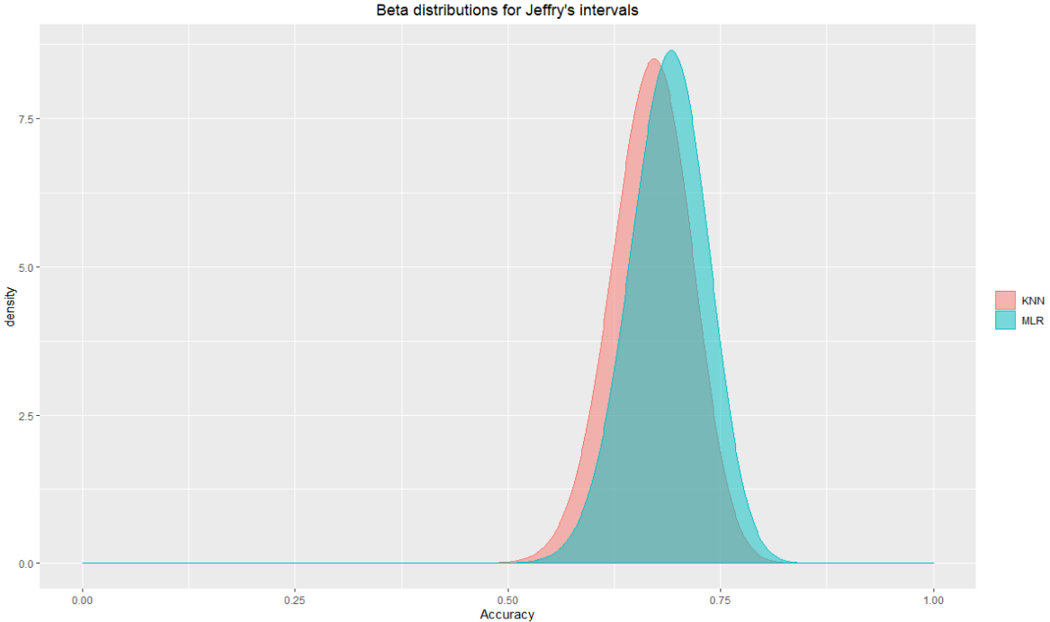
Results - LOOCV
24. Jan. 2020
DTU Compute

Slide 7
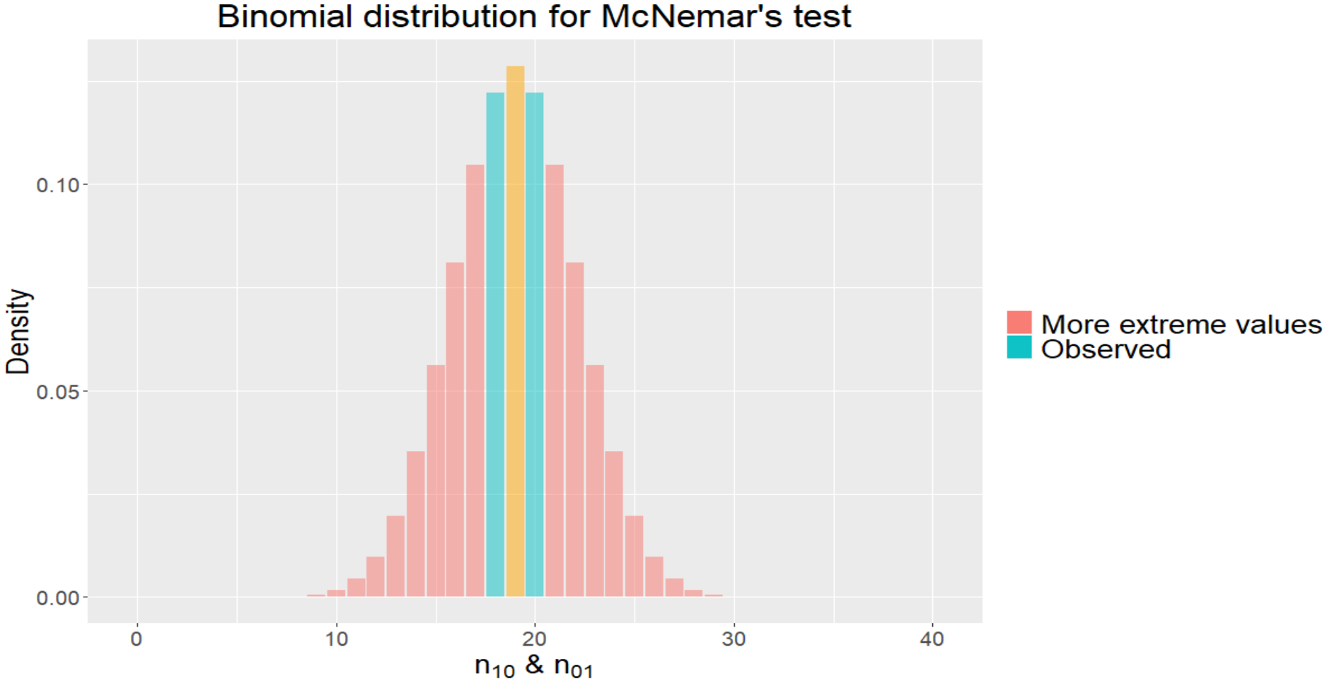
Results - Comparing the models
24. Jan. 2020
DTU Compute

Slide 8
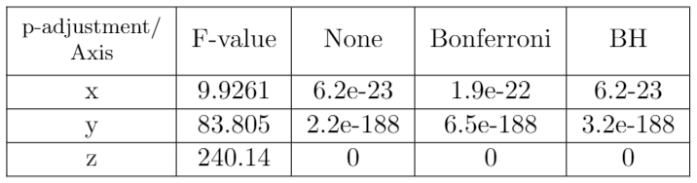
Results - ANOVA
24. Jan. 2020
DTU Compute

Slide 9
Discussion
KNN vs MLR
Min-max / mean
ANOVA assumptions
24. Jan. 2020
DTU Compute

Slide 10
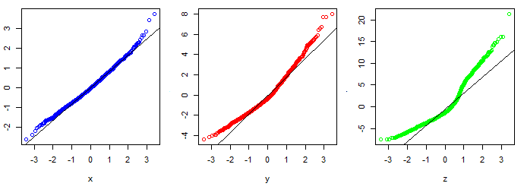
Discussion
ANOVA assumptions
Normal distribution
Q-Q plots
24. Jan. 2020
DTU Compute

Slide 11
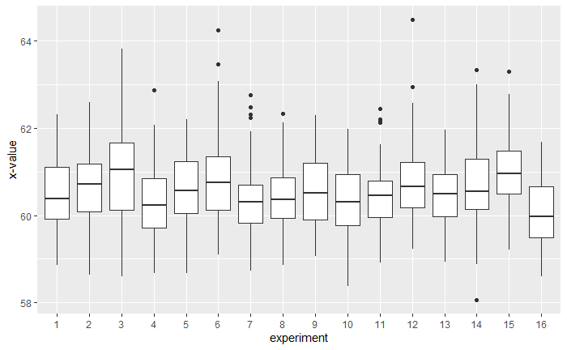
Discussion
Boxplot
ANOVA assumptions
Equal variance
24. Jan. 2020
DTU Compute

Slide 12
Conclusion
Accuracy is around 70 %
KNN is the favorable classifier - due to less complexity
Significant difference between experiments
24. Jan. 2020
DTU Compute

Slide 13
Project 2
Phosphate in soil and the eﬀect on barley production
24. Jan. 2020
DTU Compute

Slide 14
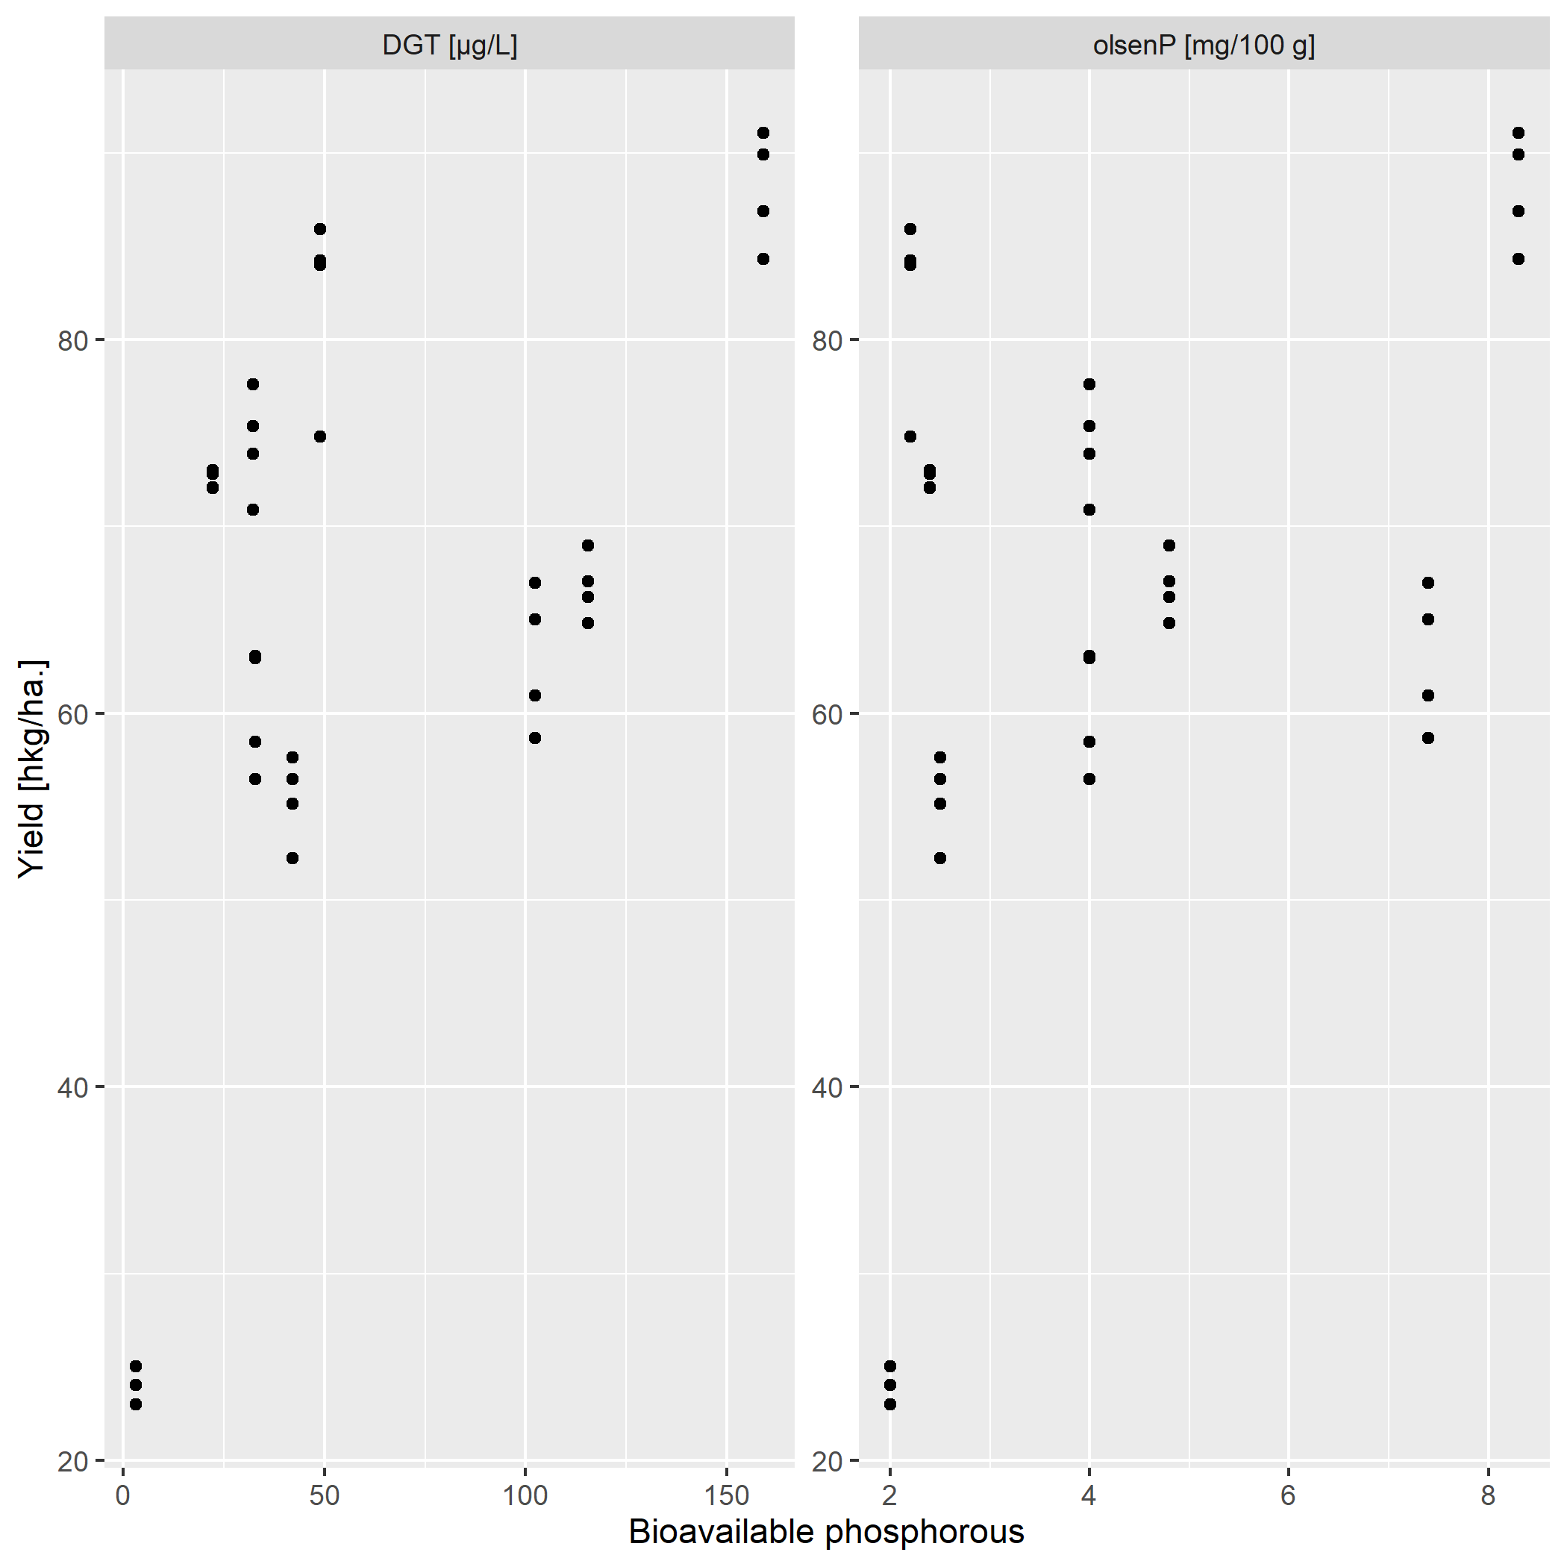
Introduction
Data
DGT vs. olsenP
Influence of phosphorus
24. Jan. 2020
DTU Compute

Slide 15
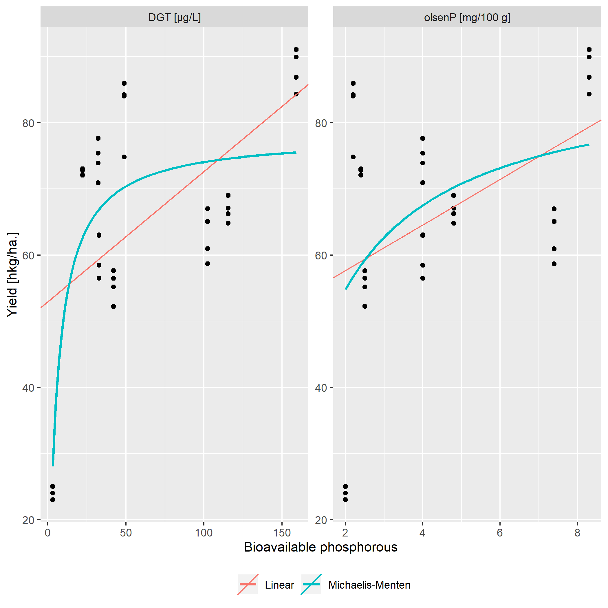
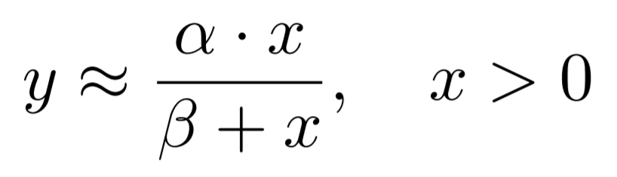
Methods
Non-linear
Michaelis-Menten model
24. Jan. 2020
DTU Compute

Slide 16
Methods
Parametric bootstrapping
Confidence intervals for parameter estimation
9 fold CV
Evaluation of models (MSE)
Wilcoxon Rank Sum test (non-parametric)
Comparison of models
Non-parametric bootstrap CI
Comparison of models
Permutation test (non parametric)
Test effect of phosphorus on harvest yield
24. Jan. 2020
DTU Compute

Slide 17
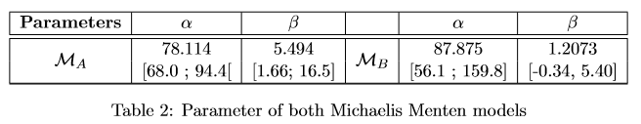
Results - Model parameters
Confidence intervals estimated using parametric bootstrapping
Interpretation of parameters
24. Jan. 2020
DTU Compute

Slide 18
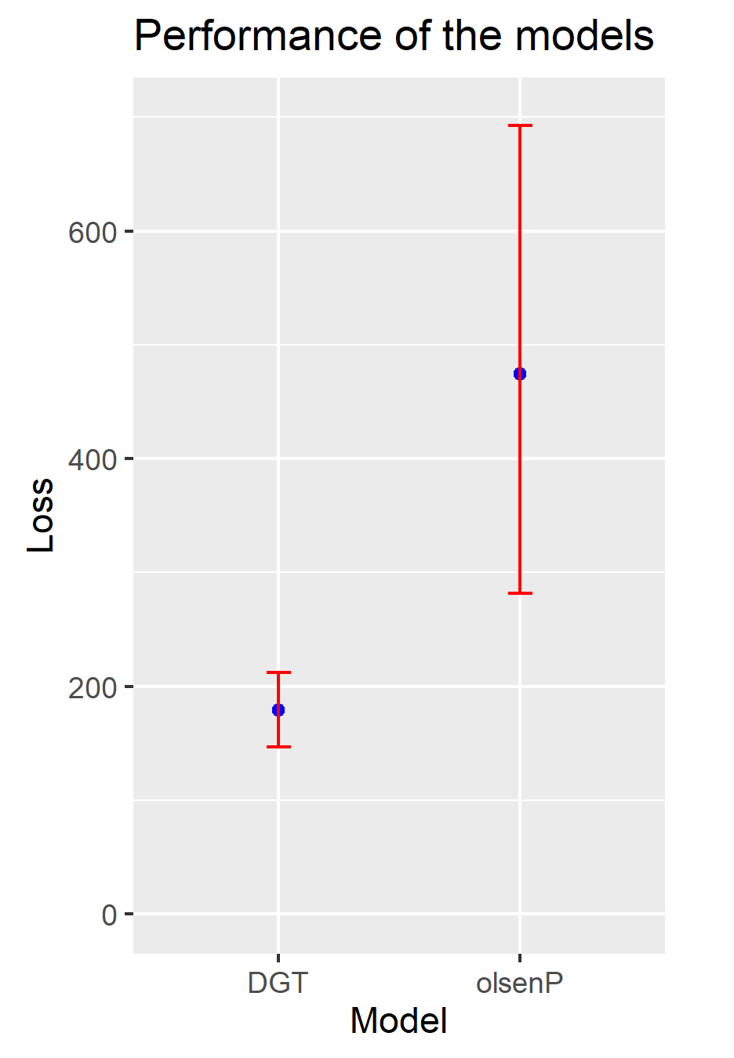
Results - 9-fold CV
24. Jan. 2020
DTU Compute

Slide 19
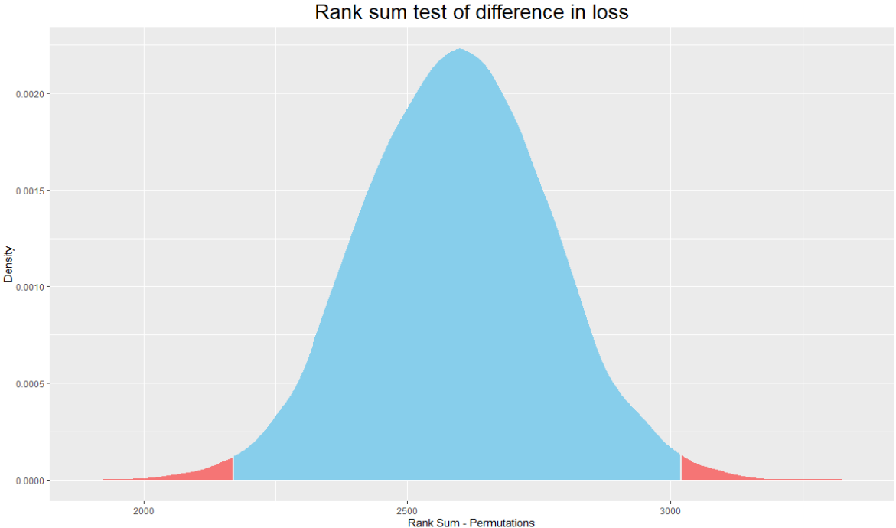
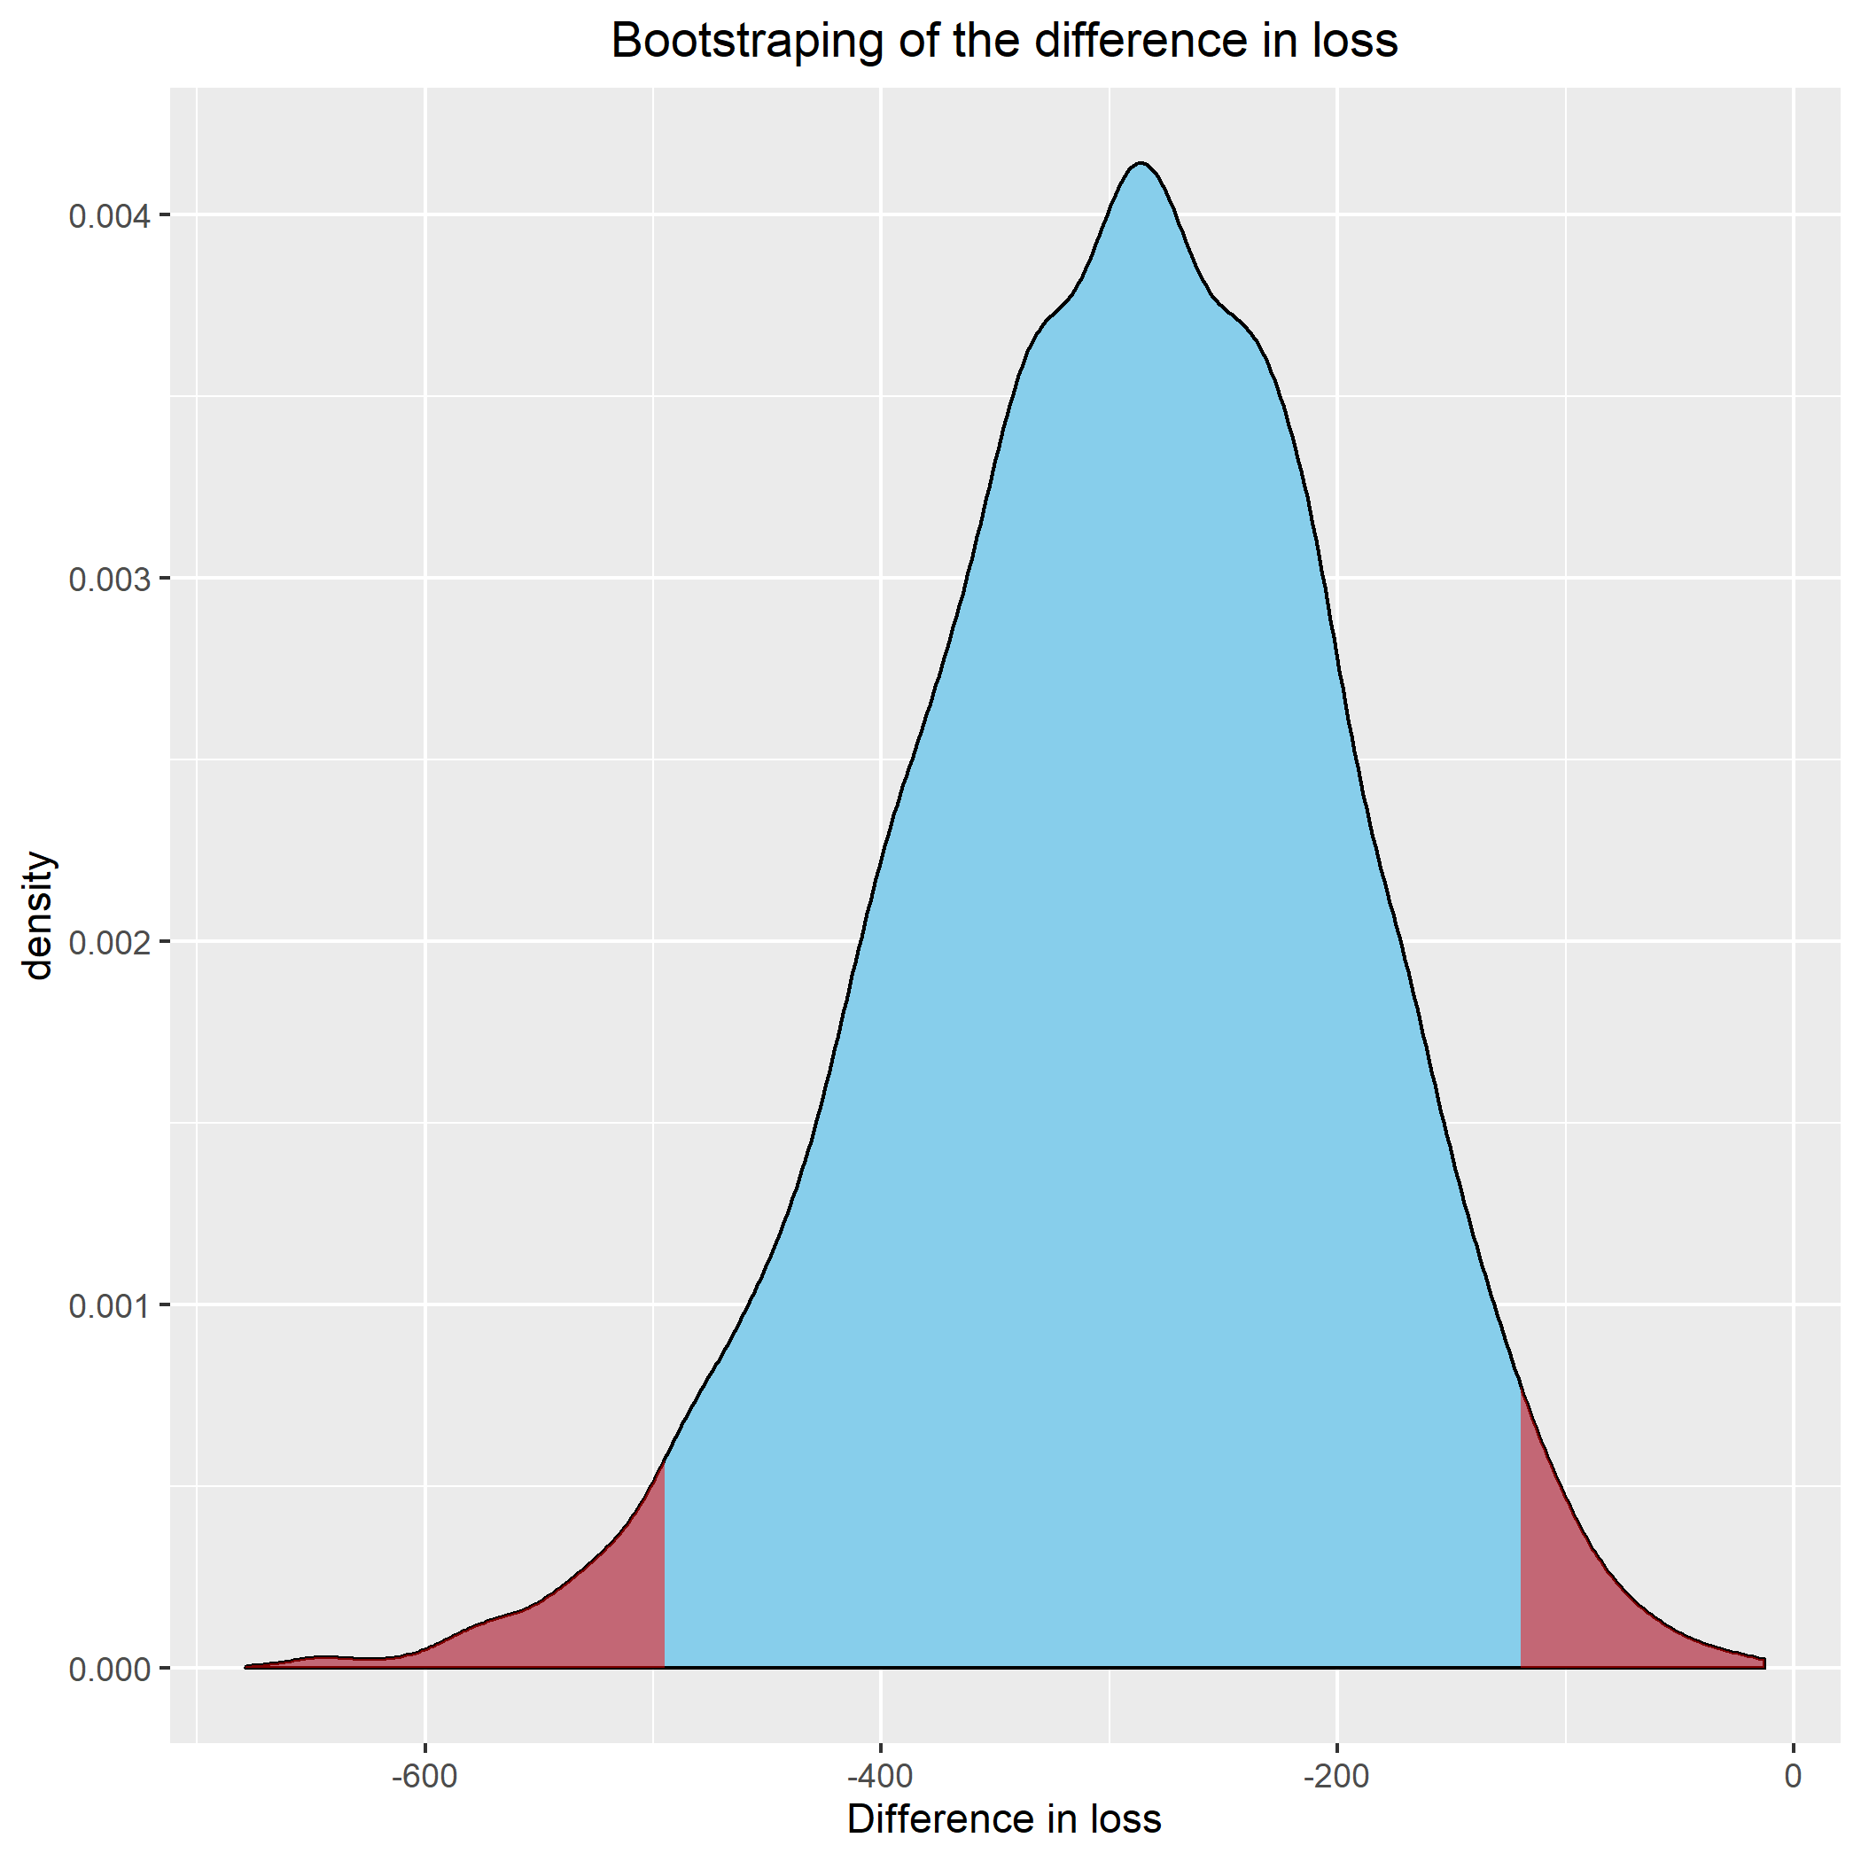
Results - difference in performance
Estimated difference in performance: -294.93
P-value = 0.014, CI = ]-495; 120]
24. Jan. 2020
DTU Compute

Slide 20
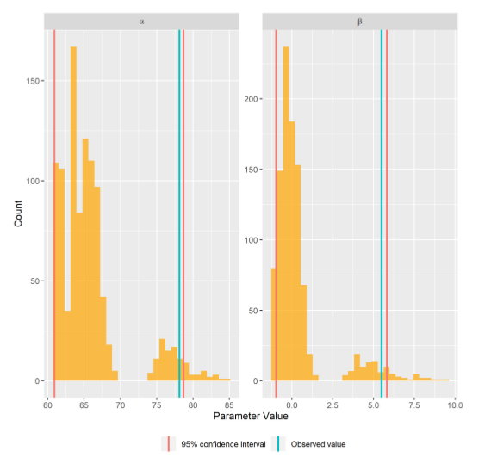
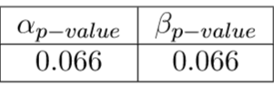
Results - effect of phosphorus
24. Jan. 2020
DTU Compute

Slide 21
Conclusion
DGT is better than olsenP
Influence of phosphorus on yield is not significant
24. Jan. 2020
DTU Compute

